Slide 1

Band Of Bandicoots
Track 2: Optimizing Transportation Efficiency
(Innovations in Transportation to Enhance Safety and Efficiency)

Slide 2
Band Of Bandicoots
Public Transport Optimization
For this problem statement, we’ve decided to address the issue of public transport optimization, more specifically, of intra-city bus routes.
As EV technology is maturing, we have come to a point where mass-adoption of electric buses is inevitable. However, compared to diesel/CNG buses, these new buses have their own set of maintenance & operational requirements. Our goal is to utilize our knowledge of computer science to devise real-life solutions to this problem. Optimization of bus routes, maintenance, down-time, and predictability can help in the easier adoption of electric buses into our public transport, which leads to a host of positive outcomes.
Track 2: Optimizing Transportation Efficiency
(Innovations in Transportation to Enhance Safety and Efficiency)

Slide 3

Why Electric Buses?
Electric buses are a massive boost to overall energy efficiency of our public transport.

Slide 4
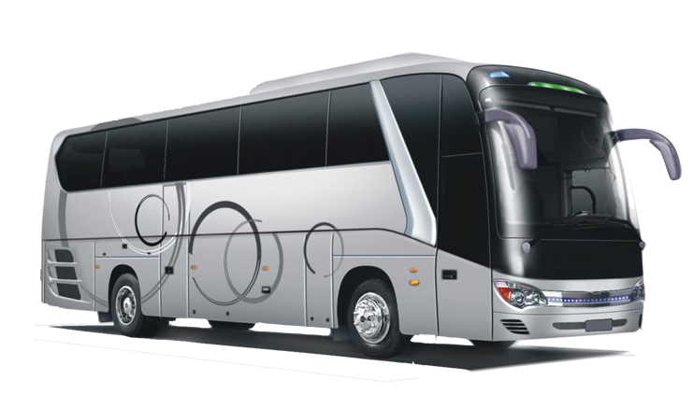
For this project, we have decided to select a specific model of Electric bus, the Volvo 7900. This is because of its popularity and wealth of pre-requisite data, both from the manufacturer and from operators. We also intend to implement user-collected data to customize the experience.

Slide 5

Our Product:
We have created a web-based application, which utilizes a data-driven approach to help operators shift their fleet of diesel buses to electric buses. The application helps operators keep track of their maintenance, operating costs, and improves route optimization.

Slide 6
For the initial prototype, the features which we intend to implement are:
A system to calculate operational cost of a specific electric bus route.
Keeping track of when maintenance tasks need to be performed.
Calculate estimated cost to insure a bus route
Keep track of maintenance costs

Slide 7

The types of maintenance required are:
Tire Replacement
Traction battery
Climate system
Suspension
Charging system
Electric motor
Brakes

Slide 8

The cost to insure a vehicle will take into account:
Maintenance expenditure
Accident risk based on which city the route operates in
Cost for spare parts & labor in that particular country
Bus driver health insurance

Slide 9

The cost to operate a vehicle will take into account:
Electricity Expenditure for charging
Cost for spare parts & labor in that particular country
Bus driver salary per hour

Slide 10

Cost Estimation:
For charging costs, we need to take into account charging inefficiency (we assume 90%), off-peak industrial electricity cost per unit in the operating city. Also, we can use the basic estimation that an electric bus uses 1.33 units per km travelled(as calculated in study by NREL for electric buses in the US). Using route distance and frequency, our application calculates annual electricity expenditure.

Slide 11

For bus driver salary, we need to use the average speed of a bus in that particular city, and the wage per hour of the driver. However, in Berlin, bus drivers are unionized, therefore they receive a fixed salary of around 30k EUR per annum.

Slide 12

Future Roadmap:
For phase-2, we intend to implement the following features:
A database-driven vehicle maintenance management system using SQL
Route Optimization for Electric Buses using Google Maps APIs
Scalability to more cities and countries
Fleet Maintenance rather than for a single bus
Connectivity to the Onboard Diagnostics Computer (OBD) of the bus to automatically sync vehicle health
Ticket price calculator

Slide 13

Project Requirements:
Our project achieves the following objectives:
Develop inventive solutions to optimize transportation
Incorporate modern technologies such as sensors, communication systems, data analytics, and automation.
Create a prototype or proof of concept demonstrating the feasibility and potential impact of the proposed solution.
Consider scalability and practicality for real-world implementation.

Slide 14
THANK YOU!
Link to Website: Electric Bus Maintenance Portal (bluewhosucks.github.io)

